Slide 1
An Urban Truck Scheduling and Routing Problem
By Zeyu Liu, Zefeng Lv, Rui Zhou

Slide 2
Background
Math Model
Anylogic Model
How we code
Future to Do

Slide 3



Slide 4
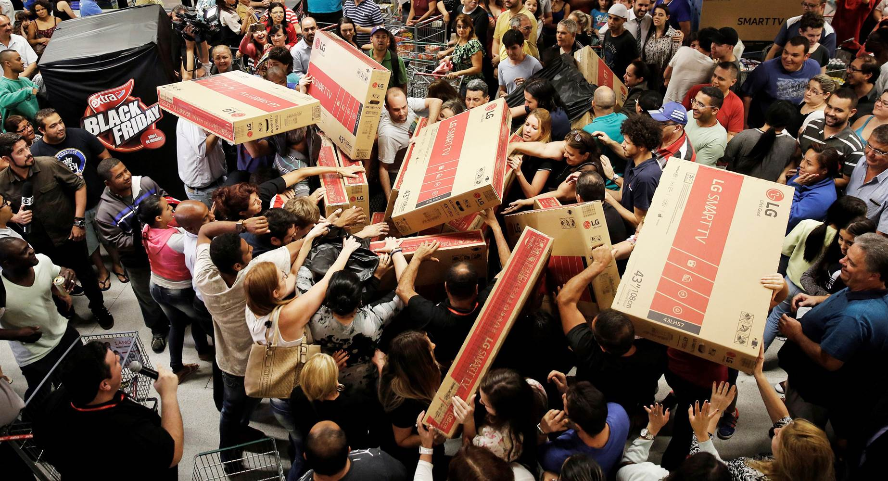

Slide 5
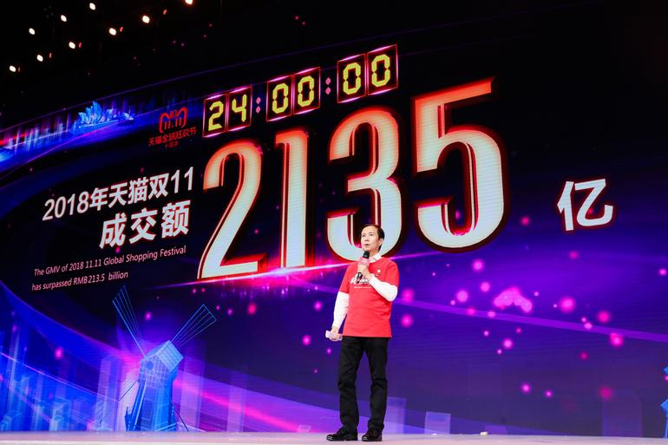

Slide 6
Double Eleven
10 billion yuan in 125 seconds ($ 1.4 billion)
213.5 billion yuan in 24 hours ($ 30.5 billion)
812 million goods
2 - 7 days (no shipping fee)
1 - 2 days ($ 2)

Slide 7

Jing Dong
Better quality
Better logistics (next day delivery)

Slide 8
What’s our problem?
One distribution center
More than 1000 customers
Decisions
How many trucks?
What’s the route?

Slide 9
Objective function
Minimize the total cost: fixed cost, traveling cost, waiting cost
Constraints
Driving range
Weight and volume capacity
Time window
Others: Recharge, multi-trips, heterogeneous fleet.

Slide 10
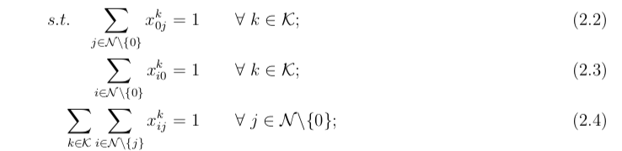
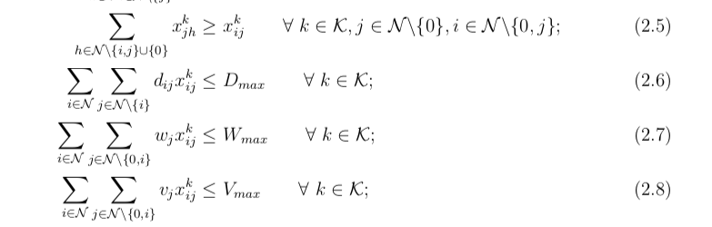
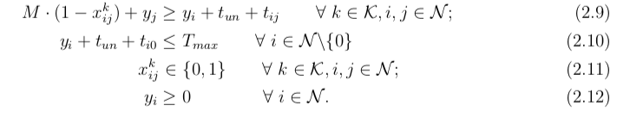

Slide 11
Data sample
Node ID | Longitude | Latitude | Package Weight (tons) | Package Volume (cubic meters) | Earliest Time | Latest Time
1 | 116.242043 | 40.072630 | 0.20760 | 0.3666 | 09:00 | 12:00
2 | 116.403595 | 39.872945 | 0.05863 | 0.1687 | 13:30 | 14:00
3 | 116.186289 | 40.016361 | 0.03645 | 0.0745 | 13:00 | 15:00
4 | 116.508011 | 39.826296 | 0.02595 | 0.0542 | 09:00 | 10:00
5 | 116.130997 | 39.825921 | 0.0198 | 0.1117 | 11:00 | 13:30
… | … | … | … | … | … | …
50 | 116.214509 | 40.122890 | 0.01697 | 0.0260 | 11:00 | 12:00

Slide 12
Data sample
From Node | To Node | Distance (kilometers) | Transport Time (minutes)
0 | 1 | 63536 | 77
0 | 2 | 27489 | 33
0 | 3 | 62041 | 75
0 | 4 | 13365 | 17
0 | 5 | 45570 | 55
… | … | … | …

Slide 13

Complexity
Consider a smaller problem, with 50 customer locations;
Number of decision variables = ${51}^{2}−51$=$2550$;
Binary combinations = $2^{2550}$.

Slide 14

Why not AnyLogic
Optimization iterations:
No more than 500 for Personal Learning Edition;
Compared to $2^{2550}$ combinations;

Slide 15
To simplify
Sampling data;
Using another solver.

Slide 16
Sampling
R (version 3.5.1);
Taking 50 customer locations:
with corresponding “distance”, “travel time”, etc.
R Code

Slide 17
Solving
Cplex (version 12.8)
with Python (version 3.6.5) API;
Python Code:
Main;
Model.

Slide 18
Solutions
Solution File

Slide 19
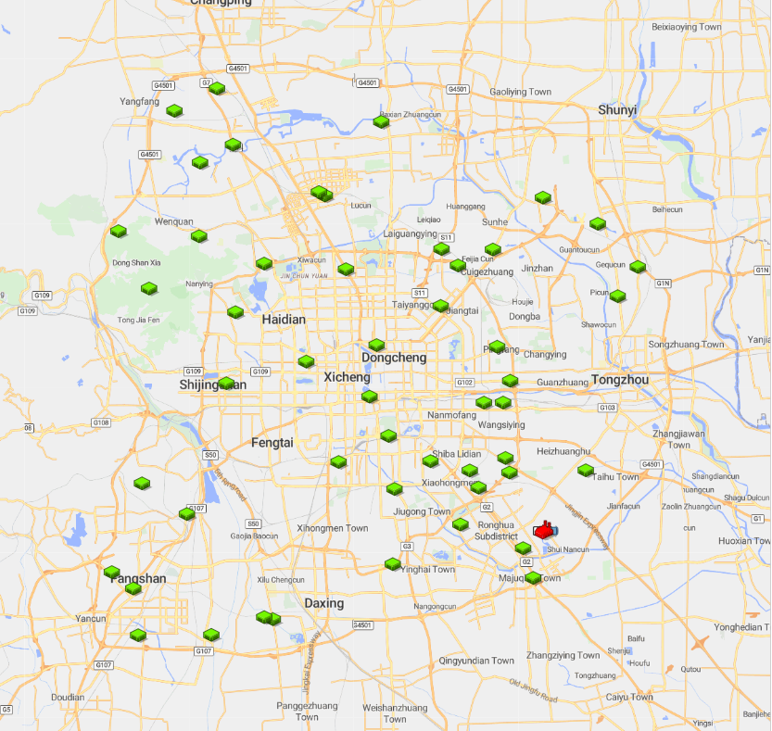
Anylogic Model
GIS MAP
1.Import database
2.Locate distributor and customers

Slide 20
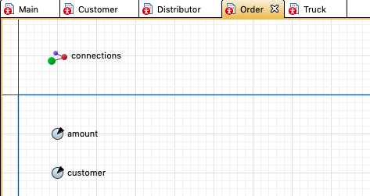
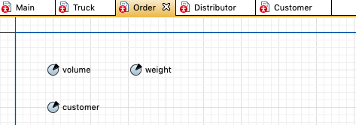
Order

Slide 21
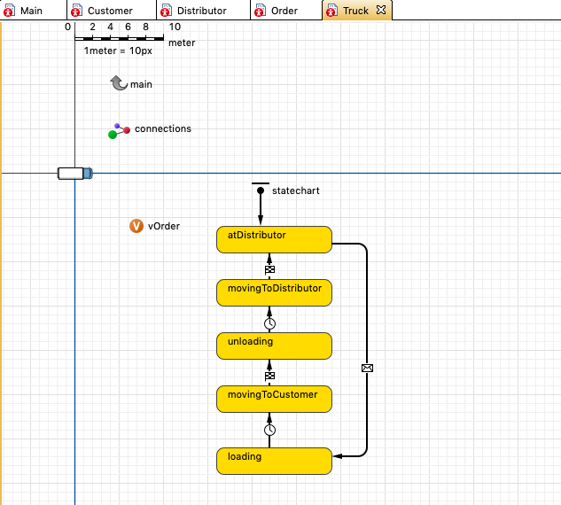
Truck

Slide 22
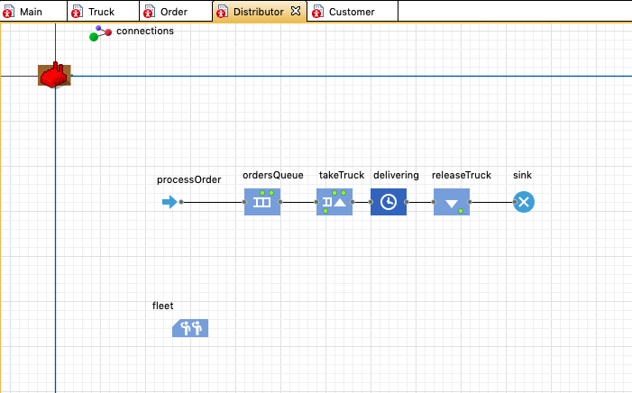
Distributor

Slide 23
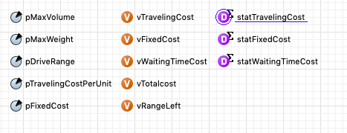
Variables

Slide 24
How we code

Slide 25
Future to Do

